Slide 1

How can housing providers help get the nation learning?
13 May 2026, 13.00 – 14.00

Slide 2
Lifelong learning has never been more important
Growth, productivity, good work, resilient communities, fuller and richer lives
Despite this, investment and participation has declined dramatically in the last decade
Large inequalities in who has access to learning opportunities
Levels of learning cannot continue to languish
It’s time to turn the tide, it’s time to get the nation learning

Slide 3

Sign the Charter to join the movement
We recognise the many benefits of lifelong learning
We commit to building a future where everyone can learn throughout life
We will lead by example to Get Nation Learning

Slide 4






















Over 200 organisations are already on board

Slide 5
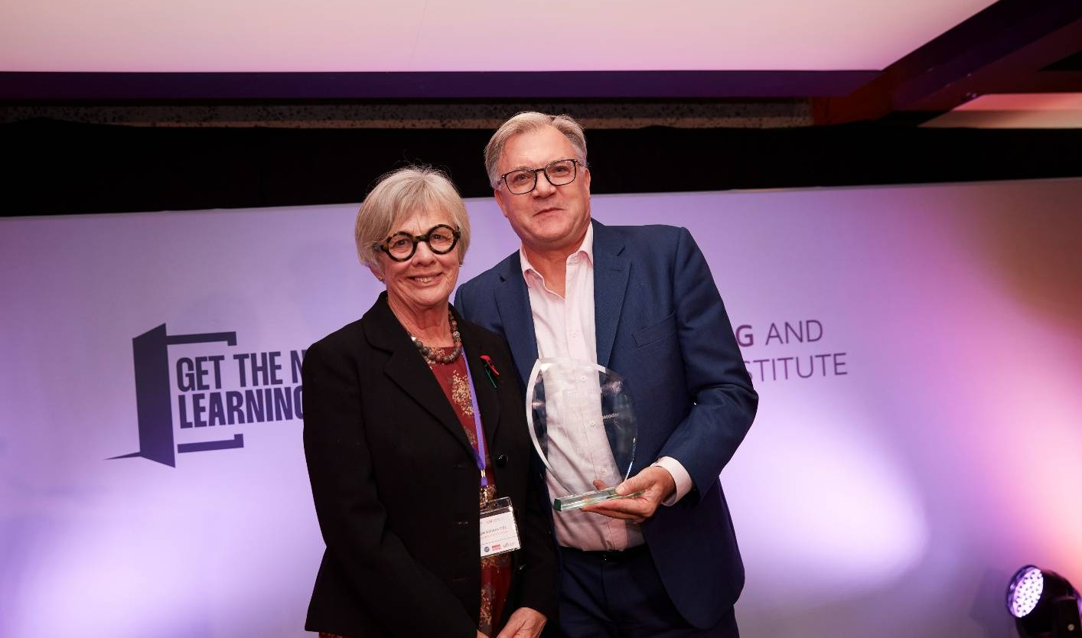
Housing providers won big at the 2025 Get the Nation Learning Awards
MSV Housing won our Talent is Everywhere Award
Poplar HARCA won the Stronger Communities Award
Peabody made it to the final three for the Employer of the Year Award
Opportunity to share good practice and discuss the role for housing providers in boosting lifelong learning

Slide 6
Questions for discussion
How can housing providers improve levels of understanding amongst key stakeholders on the role they are playing?
How can housing providers maximise the role they play in boosting lifelong learning?
What support do housing providers need to play their full role?

Slide 7



EMPLOYMENT AND TRAINING SUPPORT IN THE COMMUNITY

Slide 8
What do we offer?
1-2-1 Support
Referrals for Training
Volunteering internally and externally
Work Placements
Internships
Support in schools
Localised Jobs Fairs
Jobs Clubs

Slide 9
How do we reach our hardest to reach communities?
Being in the community
Flexibility in delivery
Building trust in the communities
Each one teach one approach

Slide 10
Breaking down the barriers
Partnership Building
Varying age-appropriate support
Localised delivery
Incentivise - Vouchers
Closing a digital divide
Customer Voice
Feedback

Slide 11
Why has this been so successful?
Rapport in the community
Delivering on what has been promised
Collaboration
Flexible
Supporting community groups offering training and learning opportunities
Open door policy

Slide 12
What is next...
More collaborative partnership working across our stock to have a larger offer
Funding to expand the team and offer
Opportunities to Network and share a wide offer

Slide 13
Thank you for listening
Contact Details
Natalie.Samuels@msvhousing.co.uk
07483684122

Slide 14


Building Stronger more resilient communities
Tanzeem Ahmed

Slide 15


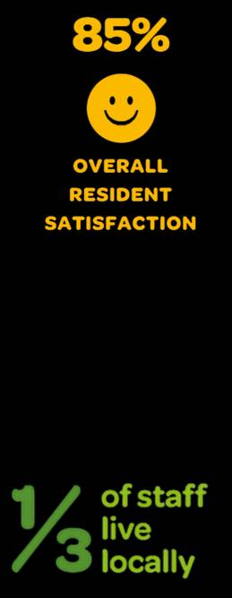
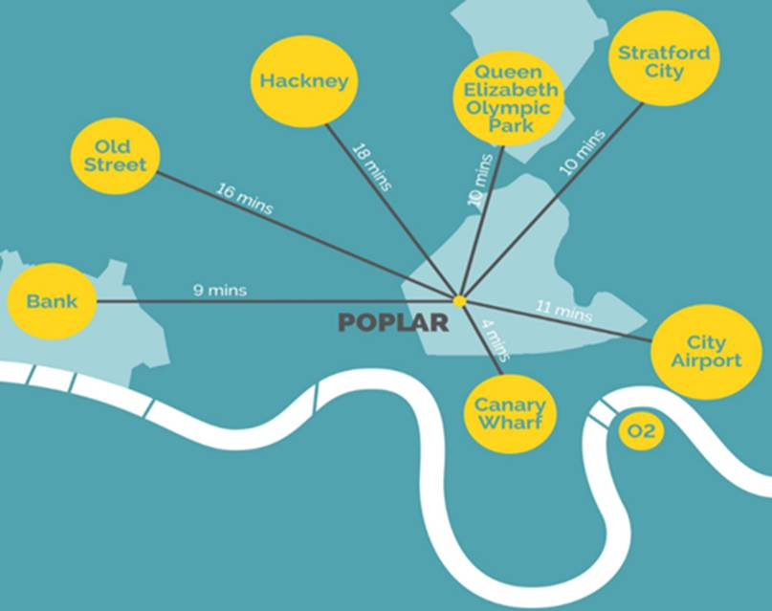
Poplar HARCA
Community-based, community motivated
Notes:
#1 for the biggest increase in new homes completions 2024-2025: Inside Housing’s Builders Survey
Positive G1 V2 C1 grading by the Regulator of Social Housing

Slide 16

Communities and Neighbourhoods (CaN)
We Do Things Differently

Slide 17



5,32
Notes:
Health Spot

Slide 18
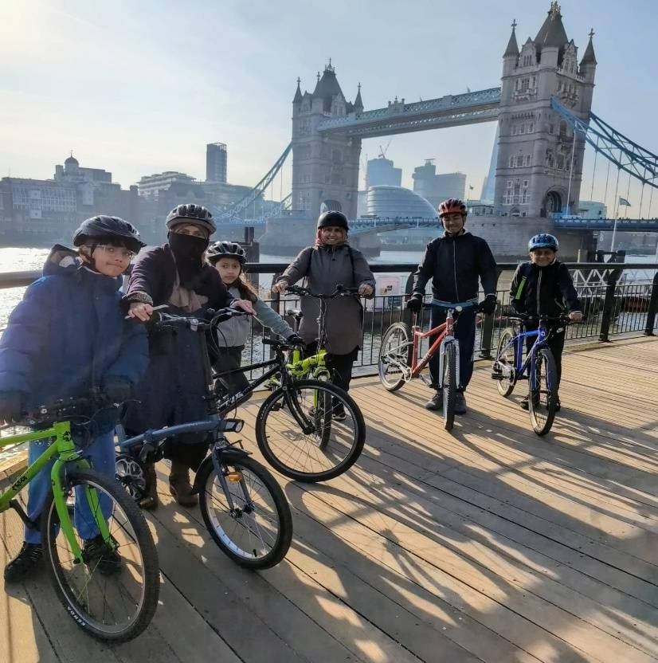


SKILLS FOR LIFE

Slide 19
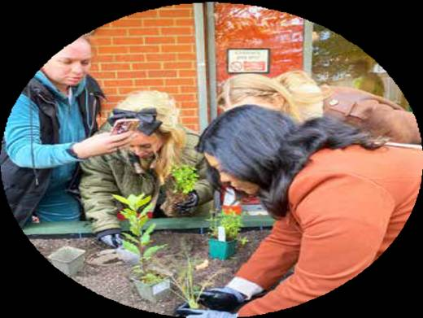
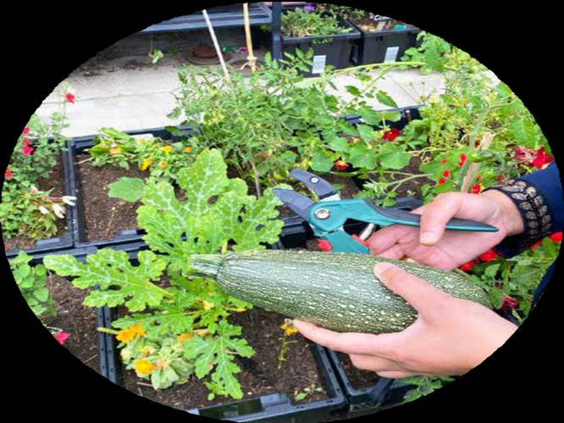
Greening Skills

Slide 20


Food & Arts
.

Slide 21

Employment and Training

Slide 22
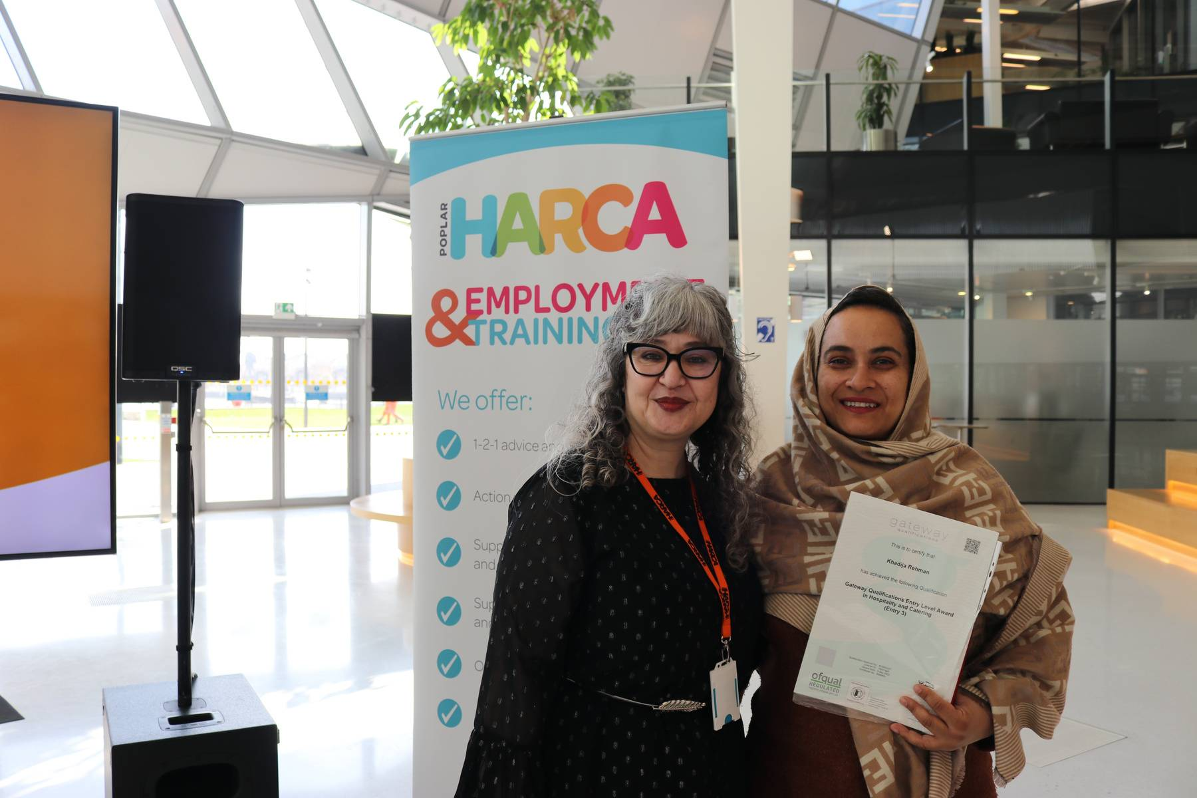


Delivering Qualifications
We offer accredited and non-accredited courses in a range of areas
250
People into jobs
711
Achieved at least 1 qualification

Slide 23
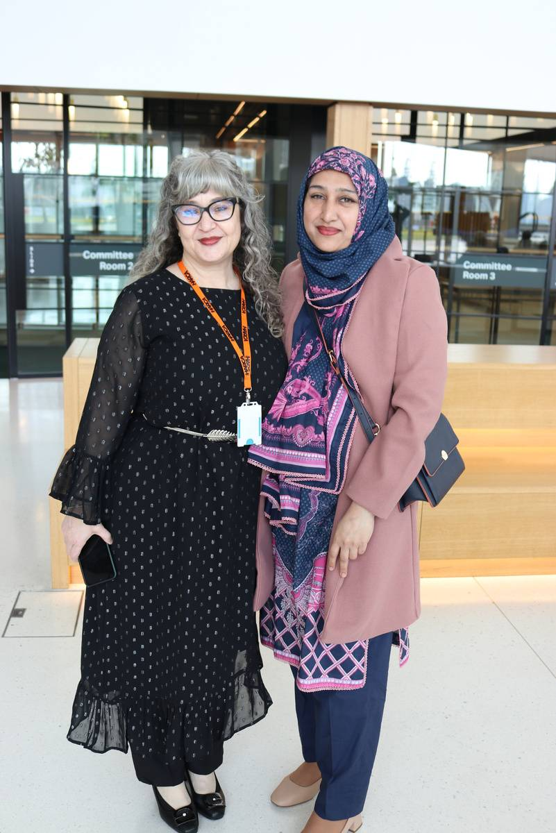

Supporting Learners
Our service delivers accredited training for unemployed and employed learners.
OFSTED: Outstanding
Awards: Get the Nation Learning, Stronger Communities Award
847
I was unexpectedly let go from my previous job, which left me feeling distressed and hopeless.
But with your team’s support, I’ve regained my confidence. My career is progressing steadily, and I’ve even been offered an interview with the Finance Department at Canary Wharf.
RESIDENT FEEDBACK
Qualifications collectively achieved by 711 trainees

Slide 24


Housing Qualifications
Start delivering CiH approved qualifications.
Courses:
  Level 2 Certificate in Housing
  Level 3 Certificate in Housing
  Level 4 Certificate in Housing
  Apprenticeship

Slide 25
Contact Details
Thehivetraining@poplarharca.co.uk
020 7510 9770

Slide 26

Growing Aspirations and Demand for Learning
13 May 2026
Presentation by: Evelina Sredovska, Economic Inclusion Lead, Peabody

Slide 27

Where you live should not determine whether you learn.
But for many, it still does.
Housing providers are uniquely placed to change this.

Slide 28
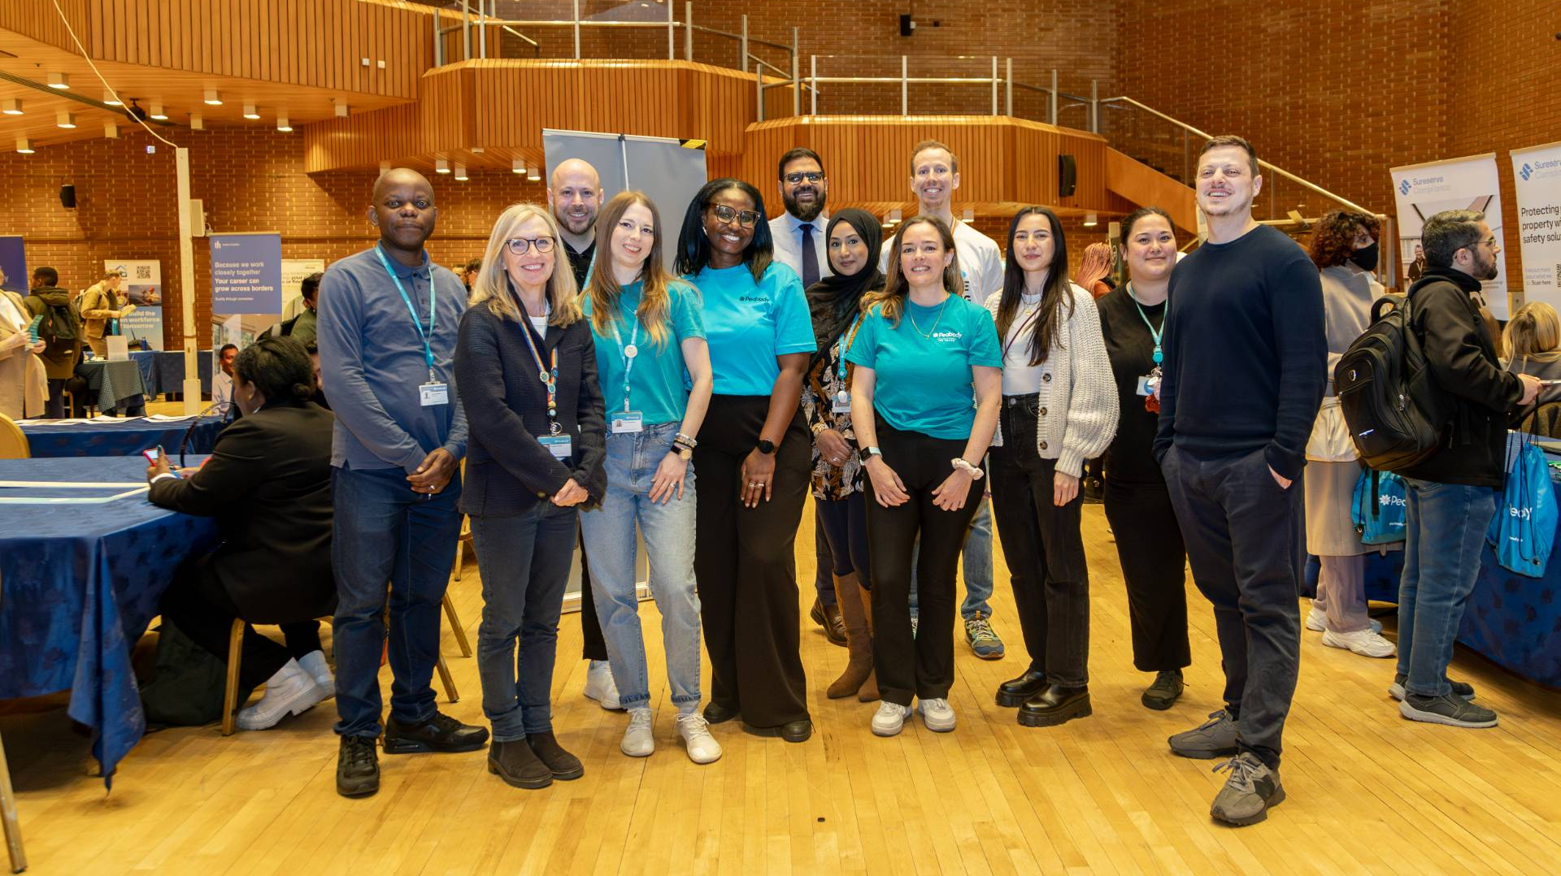
What is Economic Inclusion?
At Peabody, this is central to our mission:
Ensuring everyone can access opportunities
Regardless of background or postcode

Slide 29
The Challenge – Why People Don’t Engage
Barriers to learning are not just about provision
Confidence – “not for me”
Access – cost, childcare, travel
Awareness – don’t know what’s available
Relevance – doesn’t feel useful

Slide 30

Economic Inclusion Thematic Workstreams

Slide 31

The Role of Housing Providers
We are more than landlords.
We act as:
Place-based enablers
Connectors
We don’t just signpost opportunity - we bring it to the doorstep.

Slide 32
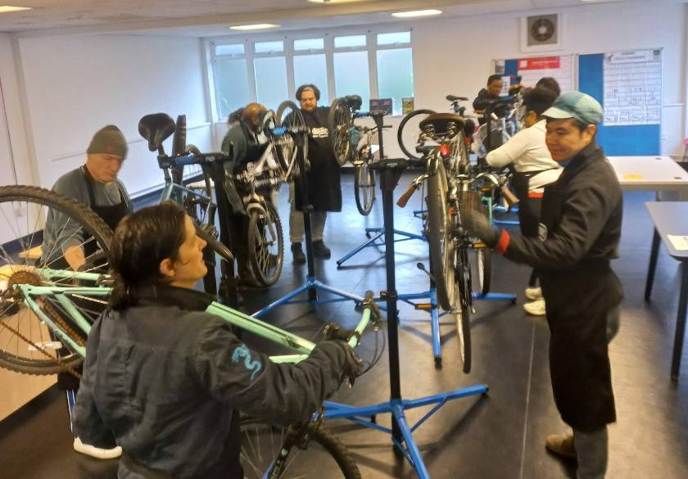
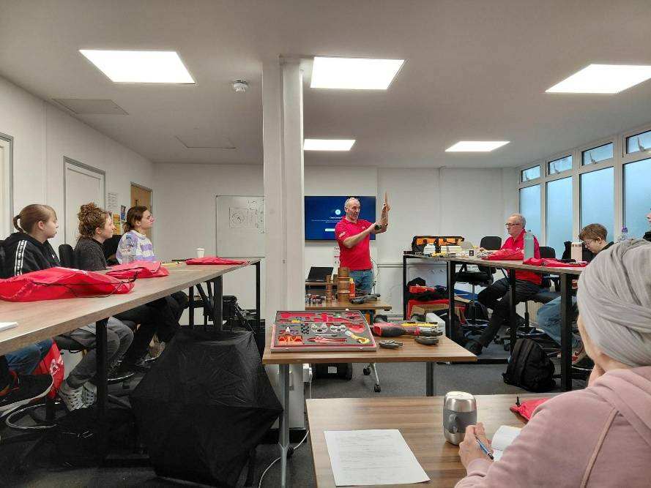
Green Skills Hub at Holloway Park
    A planning requirement negotiated with Islington Council and delivered in partnership with London Square
    A temporary on-site skills hub/classroom to provide training and education programmes for those living and working in Islington.
A unique partnership and opportunity to deliver greater impact in the community
A space with a vision to develop sustainable knowledge and lifestyle, champion women in construction and support the local economy
Level 1 and 2 Cycle Maintenance course
Introduction to plumbing course for women only cohort

Slide 33
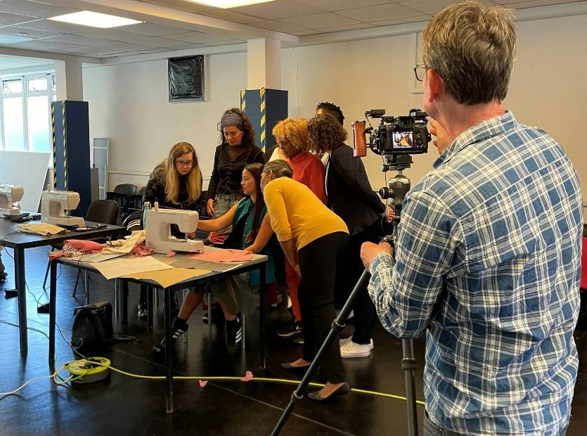


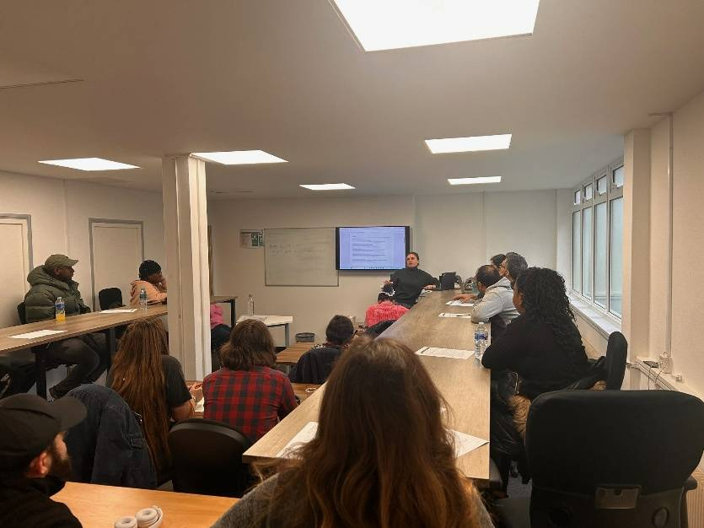

Green Skills Hub in numbers
Kundakala’s sewing course, filmed for the BBC
Highly commended at SVLG Award and Property Week RESI Awards
180+
accredited and non-accredited qualifications
100+
local residents building confidence, securing better jobs or starting a career
Received Islington ACL Partner Award Celebration of Achievement
3
local organisations that have access to private and shared spaces to run their activities at no cost
Employability session on the back of the level 2 introduction to domestic retrofit course

Slide 34

Social Housing LaunchPad
Work Placement Programme
Engaging beyond the classroom through gamified & experiential learning.
Focus on life skills:
  Communication
  Confidence
  Public speaking
  AI awareness
Change the experience → unlock engagement

Slide 35


Slide 36





FEATURED IN:

Slide 37
What Works?
Growing participation in learning means:
Start with trust, not courses
Bring learning into local spaces
Make it relevant to real lives
Support the whole person
Co-creating
It’s about empowerment, not just provision.

Slide 38
If We Want a Nation That Learns…
We must meet people where they are
In homes, communities, everyday life

Slide 39
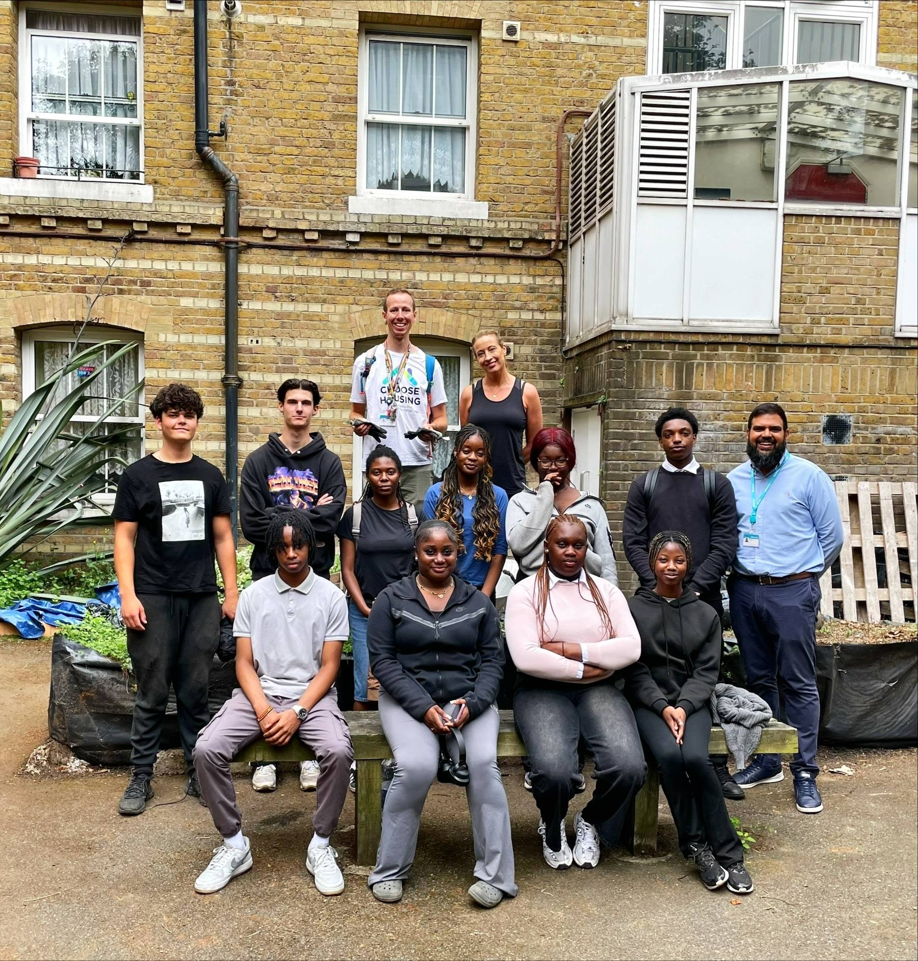
Housing is not just about homes - it’s a platform for opportunity and lifelong learning.

Slide 40
Thank you!

Slide 41
Questions for discussion
How can housing providers improve levels of understanding amongst key stakeholders on the role they are playing?
How can housing providers maximise the role they play in boosting lifelong learning?
What support do housing providers need to play their full role?

Slide 42
Nominations for the 2026 Get the Nation Learning Awards are now open!
The biggest celebration of lifelong learning in England
Recognises examples of adult learning that support healthier futures, stronger communities, more opportunities, regional growth, and richer lives.
Employers, learning providers, adult learners, community organisations, and local/regional government are all eligible
Nominations close on 4 June
Winners will be presented at The Royal Society London on 4 November

